Slide 1
IQ Root Technologies
Client Presentation – March 2017

Slide 2
Introduction to IQ Root Technologies
Mission: Enable Humanity for better livelihood through Technology
Values: Excellent Customer Experience, Great Partner Relationship and Best Team working on next generation technologies
Capabilities: Embedded Systems, eCommerice, Mobile App Development, Cloud Technologies, Big Data/Data Analytics
Skills: Embedded Systems, C, C#, Java, JSON, ASP.NET, HTML5, CSS3, MySQL, XAML

Slide 3
Why IQ Root Technologies:
Strong proven Management Team with international experience & exposure (NA, Europe & Asia)
Understand Client’s culture and businesses effectively
In-depth expertise on cutting edge technologies such as Cloud Technologies & Internet of Things (IoT)
Bright talent team who are capable to translate client’s pain points into excellent solutions
Quick turnaround capabilities with great quality solutions/products

Slide 4
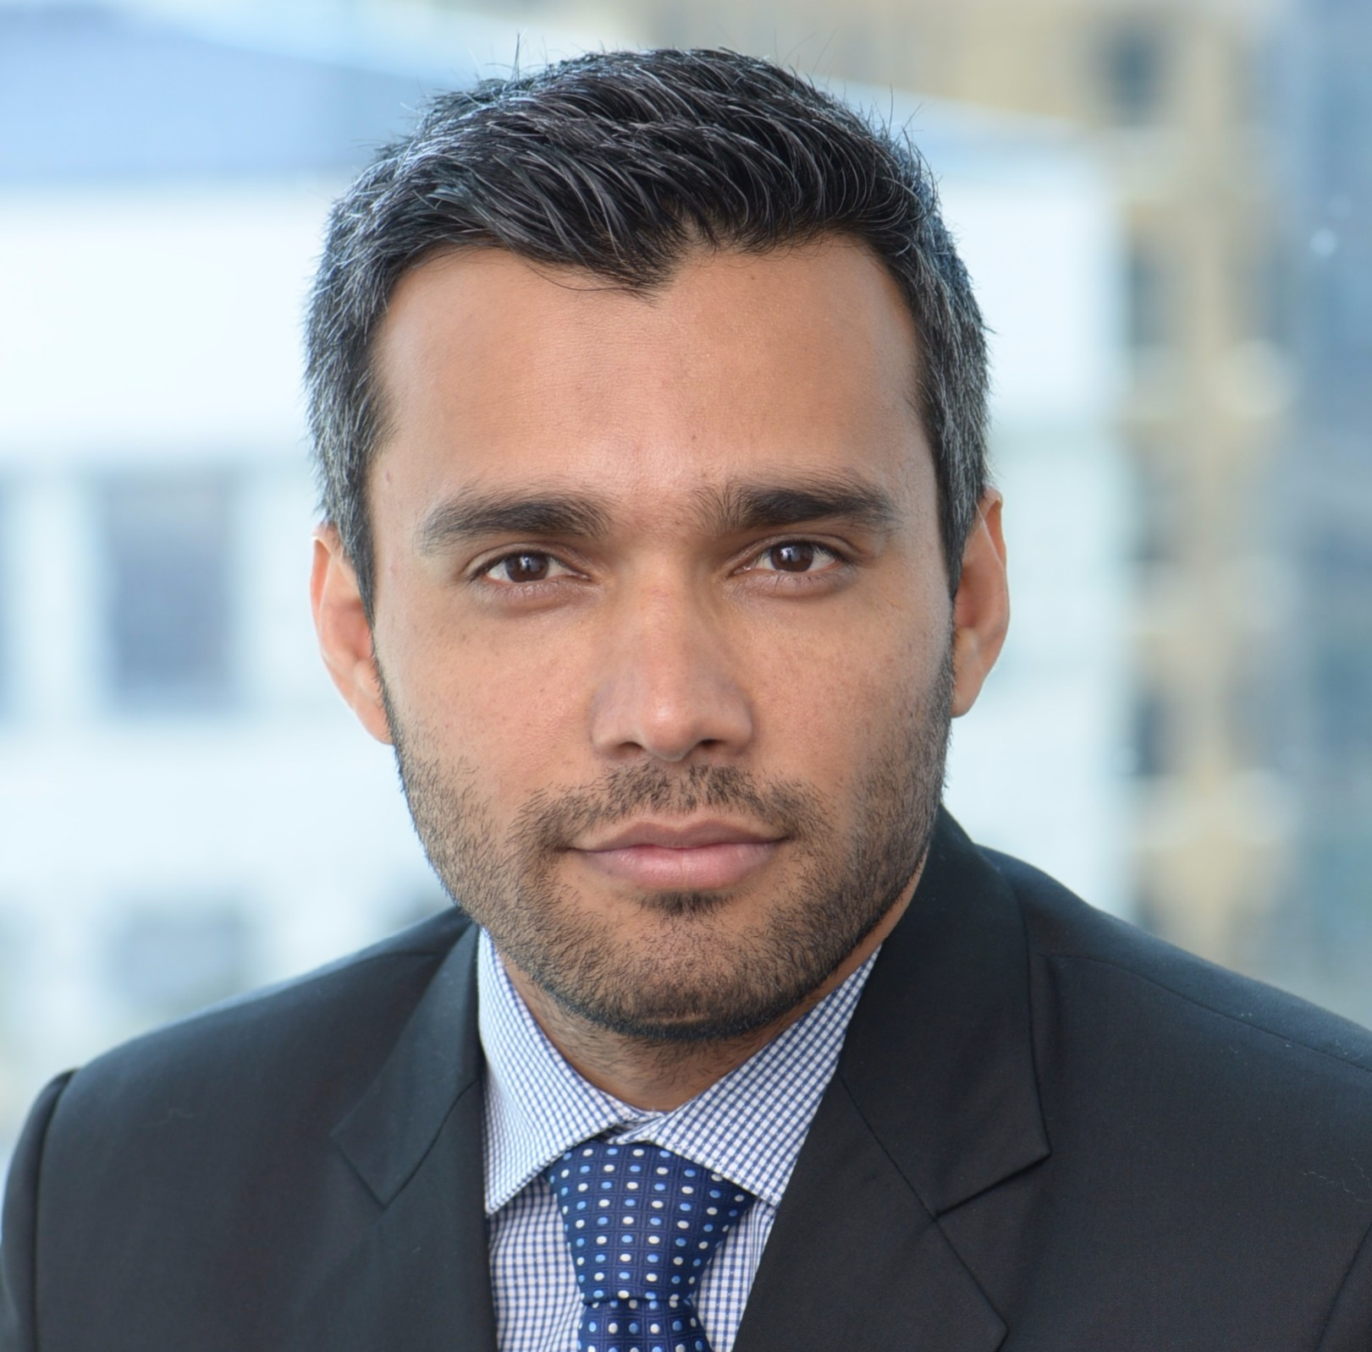
Management Team
Vijay Ranganathapura Co-Founder & Chief Executive Officer (CEO)
15+ years global experience in North America, Europe & Asia across 8 diverse industries. Have incorporated, managed and sold a successful business for profit before. Have strong expertise in Client Relationship, Tech Strategy, Business Operations, Account, Delivery & Program Management. Have worked with some of the best branded companies globally that include Deloitte, RBC, Siemens, Bosch, Tata & HCL.
Mahantesh Ganachari Co-Founder & Chief Technology Officer (CTO)

Slide 5
Products and Services
eCommerce – Currently working on a new idea that would revolutionize the eCommerce business by taking the internet to common people.
Internet of Things (IoT)
Mobile App Development
Embedded Systems – Strong expertise in both hardware and software product development
Big Data/Data Analytics

Slide 6
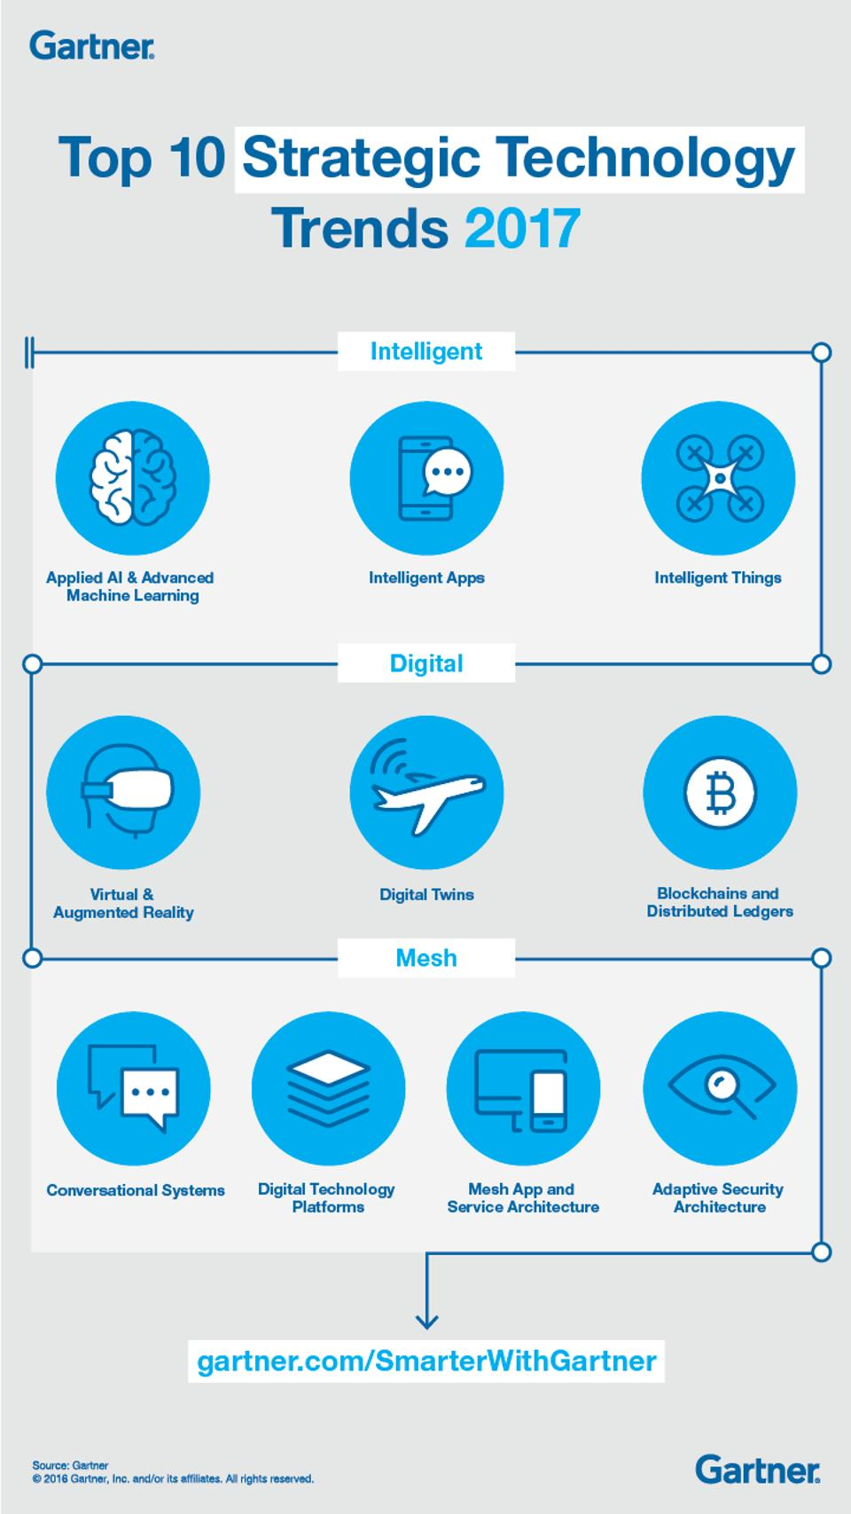
Notes:
https://www.forbes.com/sites/gartnergroup/2016/10/26/gartners-top-10-strategic-technology-trends-for-2017/#62970f6a186b

